Slide 1
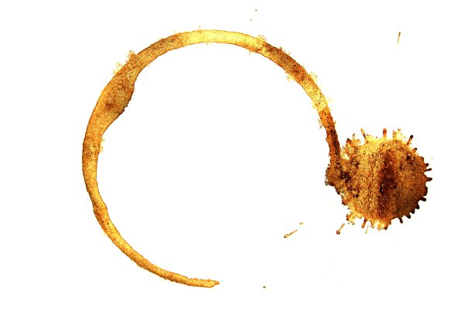
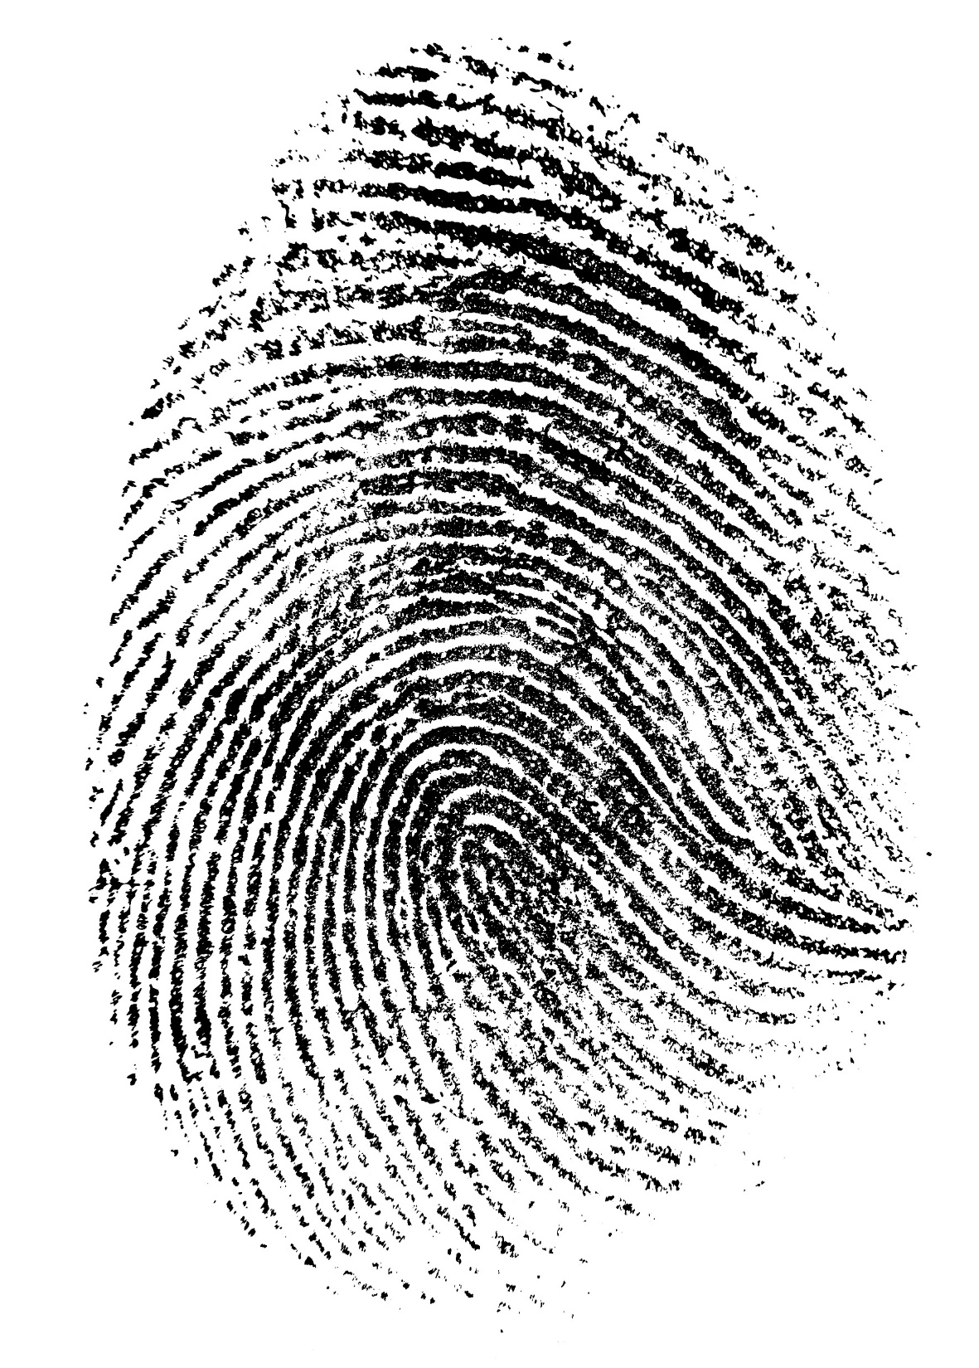
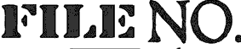
Guess Who, Gumshoe?
From the Case Files of the Effective Detective
45780B

Slide 2
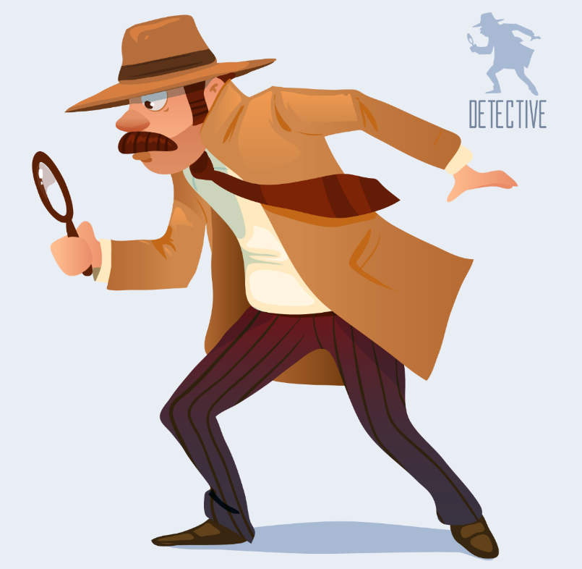

A Most Effective Detective
During this unit students become Probationary Gumshoes, working under the guidance of the Effective Detective (you!), who will give them evidence from a variety of old case files as well as opportunities to practice their skills in order to help them graduate into ‘Effective Detectives’ themselves!

Slide 3
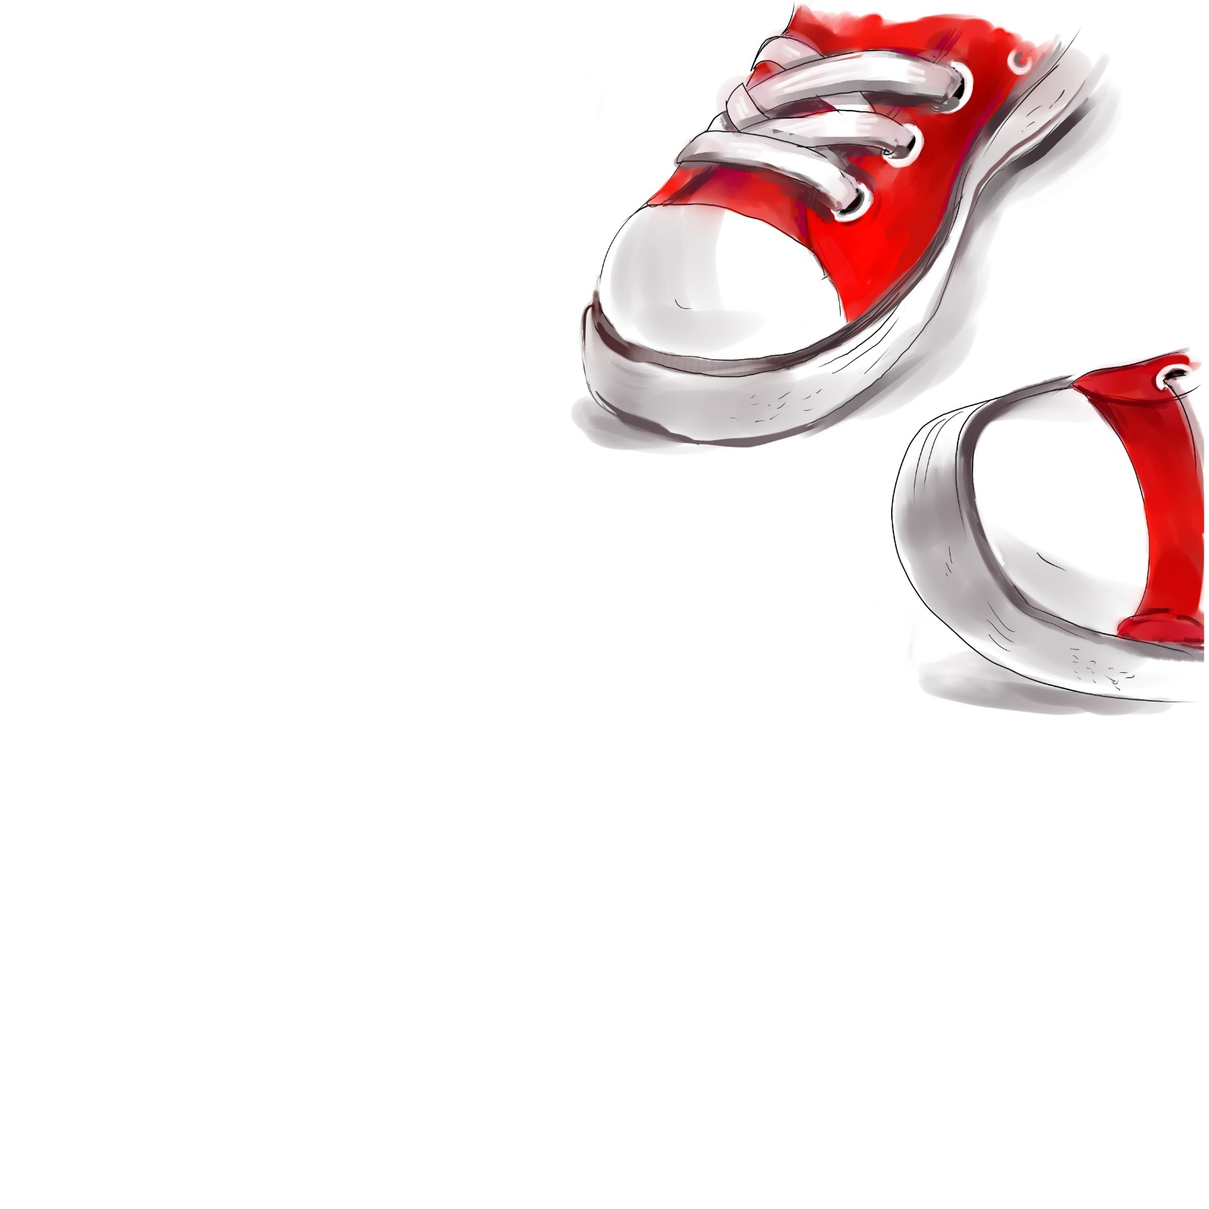
Gumshoe:
noun gum·shoe \ˈgəm-ˌshü\ An old slang term for a detective or investigator (police-affiliated or private).
History: Shoes in the late 1800s were made of gum rubber - the soft-soled precursors of the modern sneaker. The phrase "to gumshoe" meant to sneak around quietly and stealthily, as if wearing gumshoes. By about 1908 the term "gumshoe" was used to refer to a police detective, and the term has stuck ever since (pun intended).

Slide 4
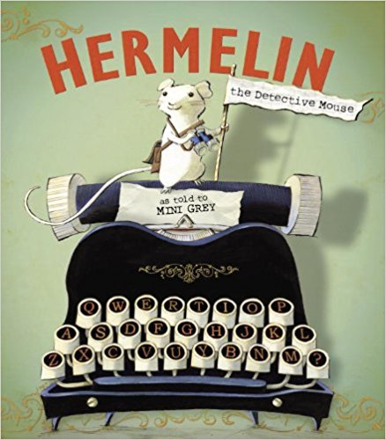
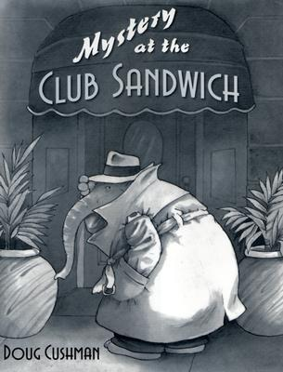
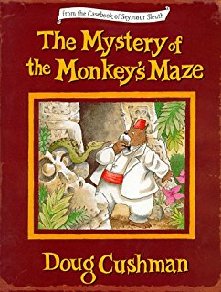
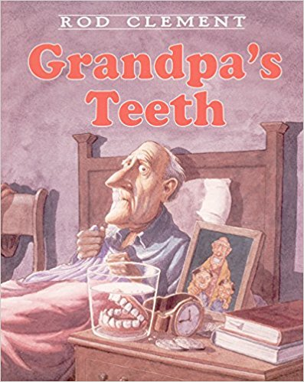
Fun books to Access Prior Knowledge

Slide 5

Practicing the Art of Observation
45780B
Show students an image with a great many details, ex. the cover of a kids’ mystery book or any image with lots of detail.
Give the group about a minute to look at the picture, encouraging them to make a mental note of as much as they can, including small details that they think others will overlook.
When the time is up, put the picture away and create a (long as possible) list of things observed as a group.
Practice variations as time allows.

Slide 6
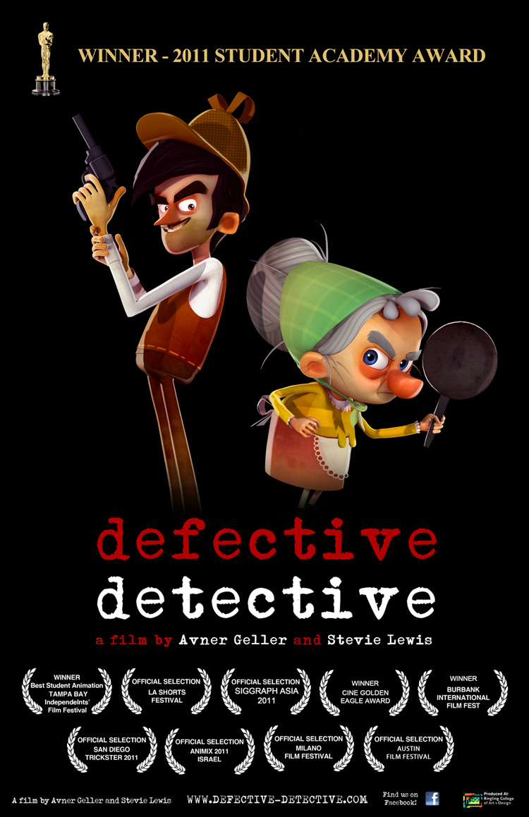
Do people remember the same thing differently?
Guide students to begin to note how differently people remember the same event or a movie. Show a short movie clip lasting three to five minutes, such as The Defective Detective, a humorous and Academy Award winning short film by Avner Geller and Stevie Lewis .

Slide 7
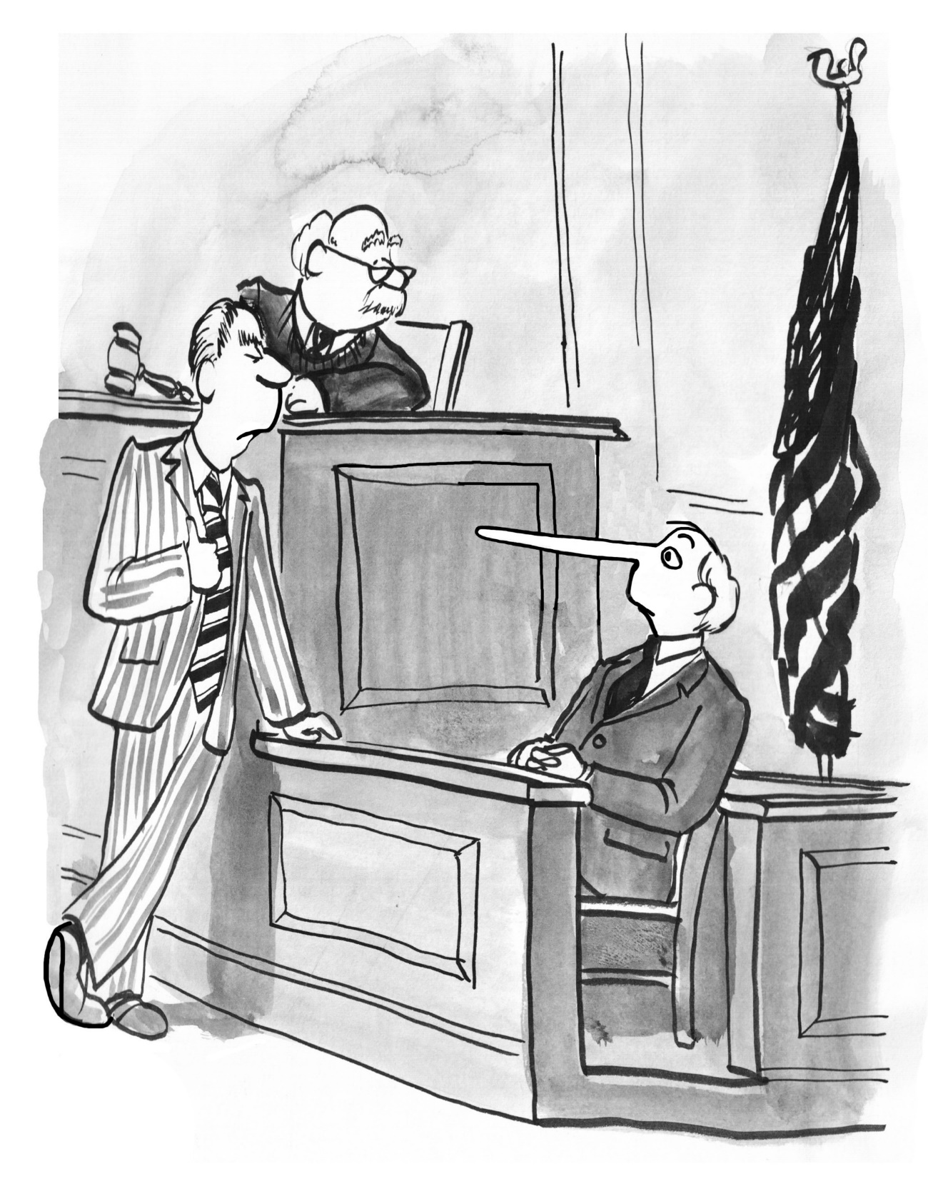
I Witness! Comparing Memories
After they watch the clip, question the students individually about what they saw and heard during the clip.
Ex. What is the first sound you hear when the video starts? How many windows were lit in the building? What is the detective’s name? What substance plopped down on his newspaper? What did the detective think it was? Analyze their answers for patterns and keep track of responses on the board.

Slide 8

Drawing Conclusions
Have students draw conclusions about the reliability of eyewitness testimony from this experiment.
Then, have students watch it again and discuss what they noticed the second time that they didn’t notice before.

Slide 9
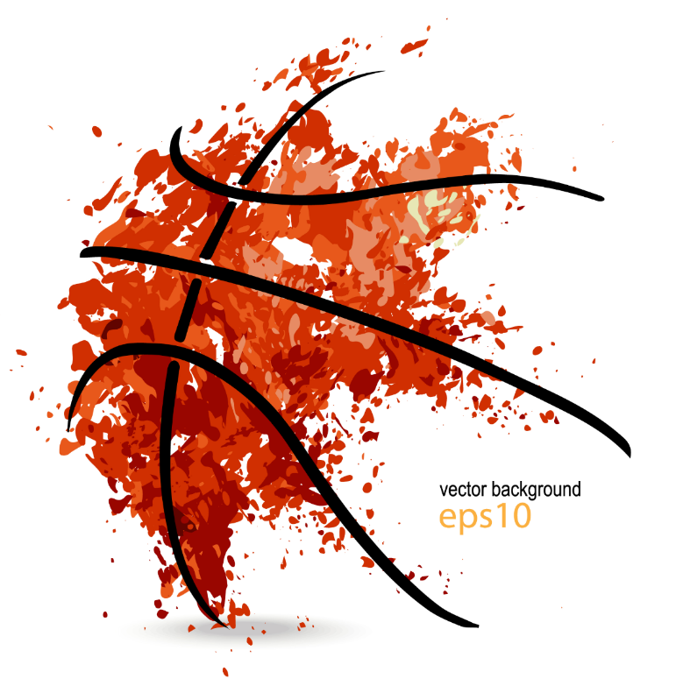

Getting ExperiMental
To further test their observational skills and see what they’ve learned have students watch the following video. Have them keep a silent count of the number of passes made by the people in white shirts and let them know that you will see how many got the correct count at the end of the video.
Let’s try it!

Slide 10
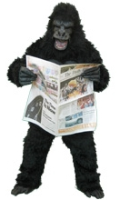
Did You See the Invisible Gorilla?
At some point, a gorilla strolls into the middle of the action, faces the camera and thumps its chest, and then leaves, spending nine seconds on screen.
Will they see the gorilla? Did you? If you didn’t, why did you miss it? What does this teach us about our powers of observation? This experiment reveals two things: that we are missing a lot of what goes on around us, and that we have no idea that we are missing so much.

Slide 11
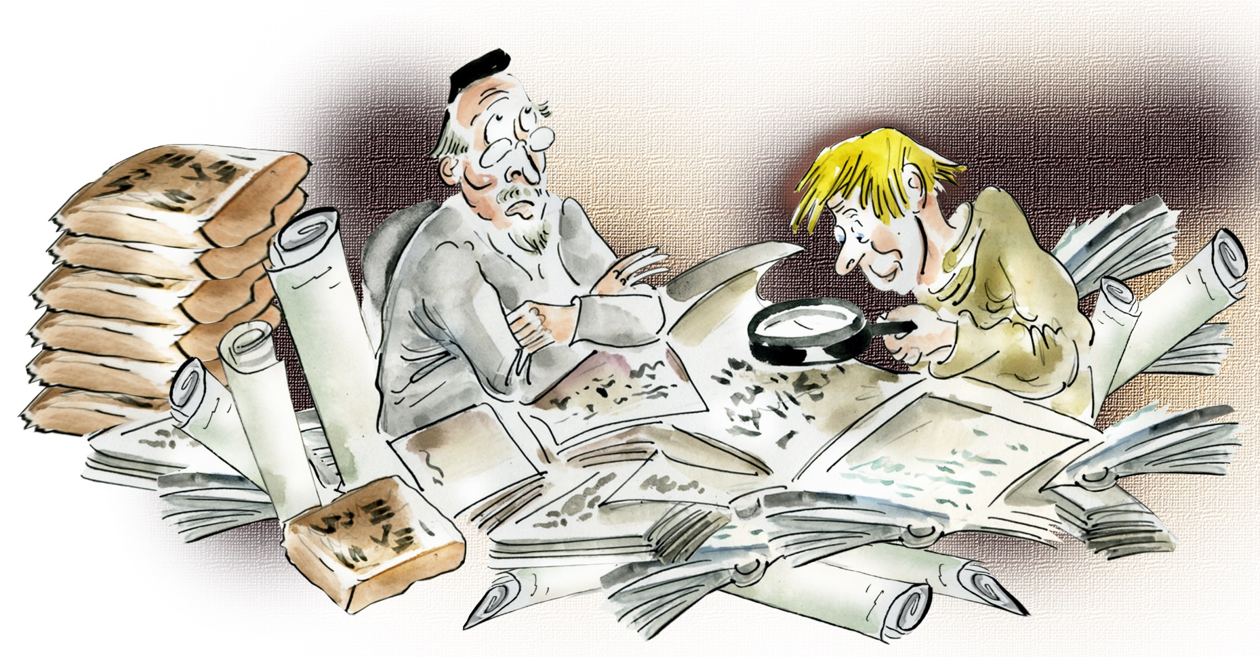
Knowing Where It all Began!
To be an effective detective, we need to be observant and we need to know how it all began, and that doesn’t just mean, “It was a dark and stormy night…” The history of forensic science dates back thousands of years!

Slide 12
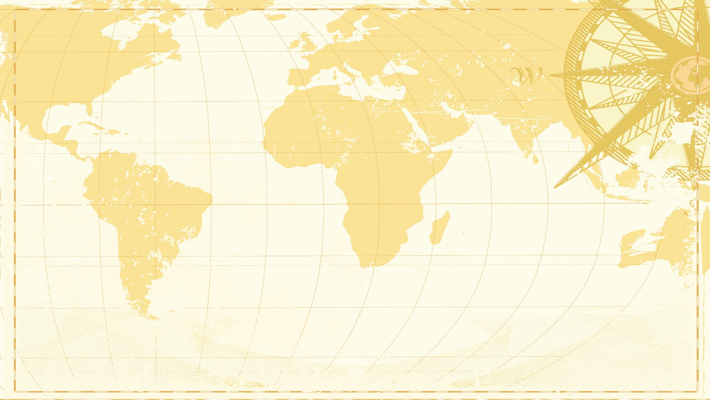
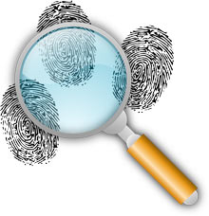
Map it Out & Follow the Clues!
Students explore the history of forensic science and work together to identify and locate the different countries, identify WHO did it, WHAT they did, WHERE they were located, WHEN it happened and mark the appropriate places where forensics took place with our forensic symbol [the magnifying glass & fingerprints] and information.

Slide 13
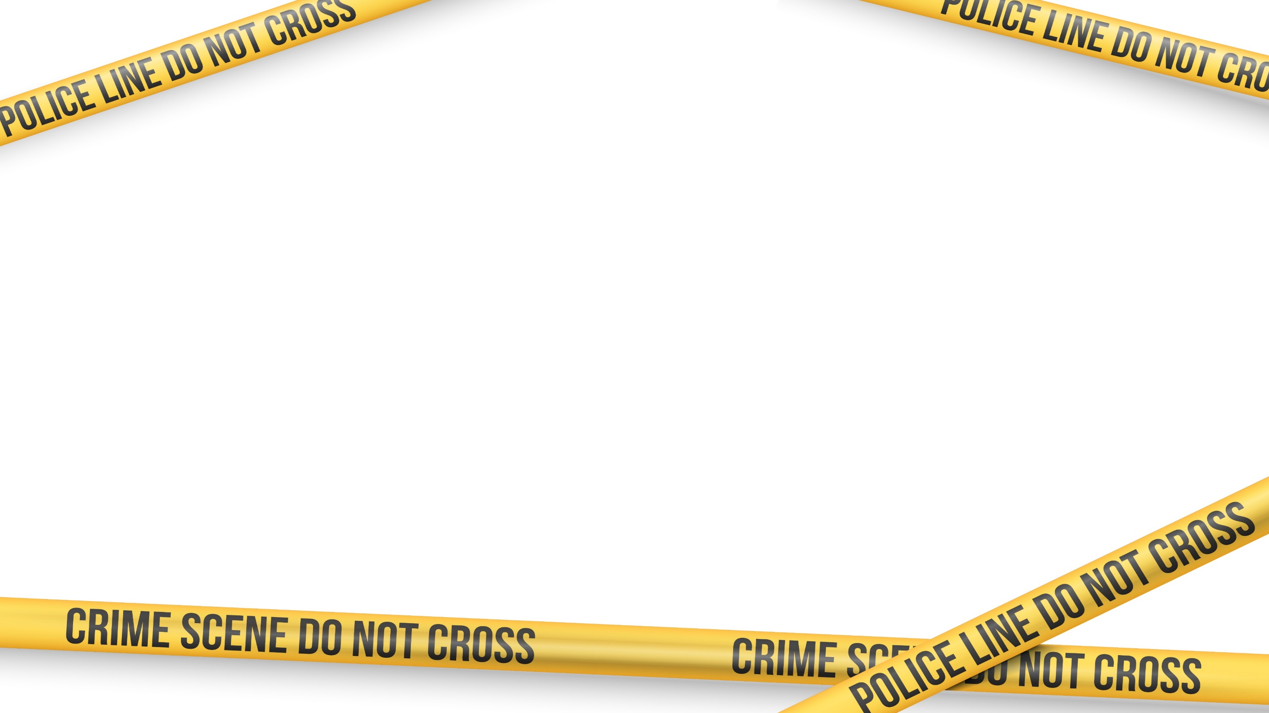
Today, in Our World. Do we have a clue?
These days viewers get to watch as investigators and detectives find and collect evidence at the scene of a crime on TV shows. Many of us believe we have a pretty good grip on the process, and rumor has it criminals are getting a jump on the good guys using tips they pick up from these shows.
But does Hollywood get it right? Do crime scene investigators really follow their DNA samples into the lab? Do they interview suspects and catch the bad guys, or is their job all about collecting physical evidence? Let’s learn a bit from the Effective Detective.

Slide 14
So, what is Crime Scene Investigation?
The Effective Detective always says that crime scene investigation is the meeting point of science, logic and law.
We’ll explore with students who’s at the scene after the crime, what they do, and how it’s done. They’ll also have a chance to test their own theories, explore scenarios and discover just what are the main elements of an investigation (including determining just what is evidence!)

Slide 15

Splat!
Bloodstain patterns left at crime scenes may be examined for clues as to what may have occurred during violent crimes. Students get a chance to explore just what blood can tell an investigator before digging into some ‘old evidence’ from your files.

Slide 16


The Perfect Recipe!
As part of their training Probationary Gumshoes must use Inquiry, Hypothesis, Variations, and Variables to determine which material, or combination of materials, is best at replicating the effects and appearances of blood.

Slide 17
The Perfect Recipe! So Far
For the sake of time today: Blender Blood: the Best Fake Blood…So Far
This recipe combines everything Probationary Gumshoes have learned so far about making fake blood and adds a few ingredients that pack a great punch (pun intended... as you’ll see below).
Tropical fruit punch (Hawaiian Fruit Punch® works great)
1 cup corn syrup
2 tablespoons of red food coloring
1 tablespoon of chocolate syrup
2 tablespoons of cornstarch
1 tablespoon of powdered cocoa
Combine all of the ingredients in the blender and mix for 10 seconds. Since different brands of fruit punch vary in color, they’ll need to use their vast experience in making fake blood to tweak the recipe to arrive at their perfect batch of fake blood.
Tip: Some fake blood connoisseurs recommend a cup of coffee in place of the fruit punch. You may need to reduce (or eliminate) the amount of chocolate syrup and powdered cocoa used in the recipe. Remember, it’s all about experimentation!

Slide 18
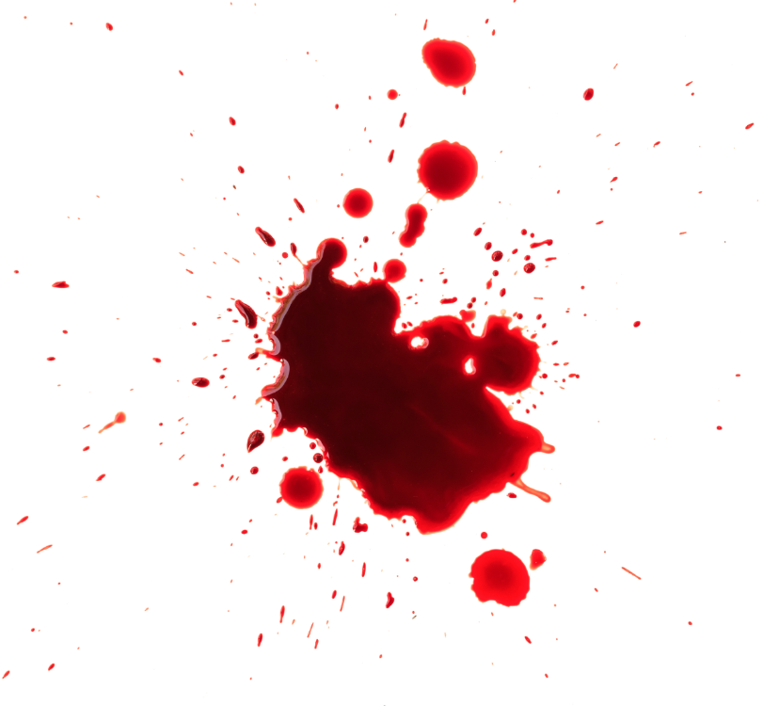
Spatter Patterns & Blood Spatter Analysis
45780B
Students try to recreate mystery spatter patterns from the case files of the Effective detective!
They’ll keep track of their data and determine the approximate height from which the drop of blood fell while taking into consideration the height and angles involved in creating the blood spatter and how quickly the blood droplets were traveling.

Slide 19

Splatter & Spray
45780B
Forensic science determines a variety of facts about crimes using blood spatter evidence, including looking at ellipses that form to determine the position of the object that made the spatter and the angle that the drops impacted the surface.
In this activity students are investigators who use patterns to determine how and where the blood got where it did and recreate spatter evidence from the Effective Detective’s case files.

Slide 20
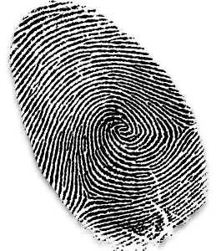
Give it a Whorl
Ever since scientists discovered that every person's fingerprints are unique, and police officers realized this one unique thing could help them catch criminals, fingerprints have been an important part of the law enforcement process.

Slide 21
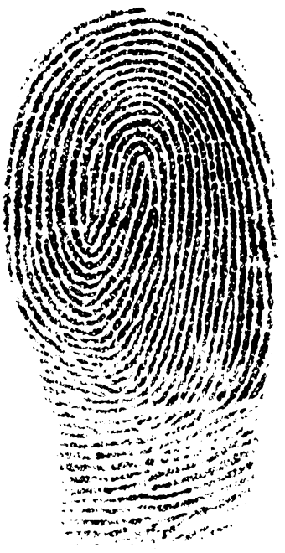
Fingerprinting
Explore the fascinating round-the-world history of fingerprinting, discuss why so many different men in completely separate areas of the world were trying to answer and solve the same kind of human problem, and then study the unique characteristics of fingerprints with students.

Slide 22
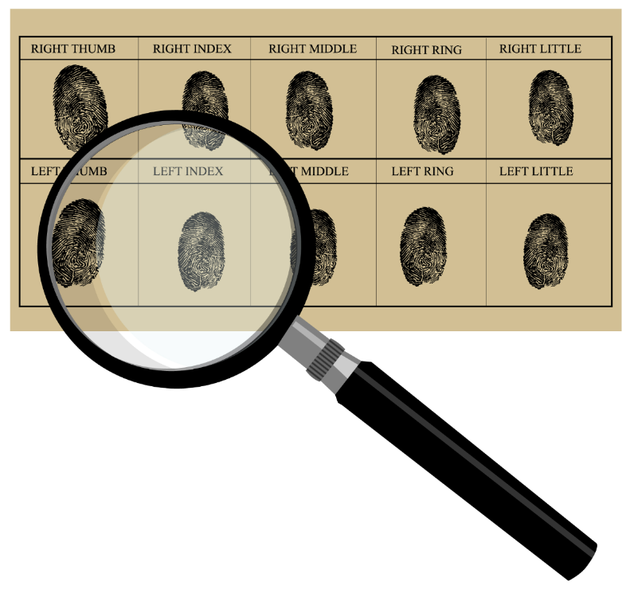
Dactyloscopy
Compare and contrast classic forms of fingerprinting to modern techniques and discover the origins of our ‘classy system’ for storing fingerprints!
Ex. When fingerprints came in, detectives would have to compare them manually with the fingerprint cards they had on file for a specific criminal (that's if the person even had a record). What might be the problem with that?

Slide 23
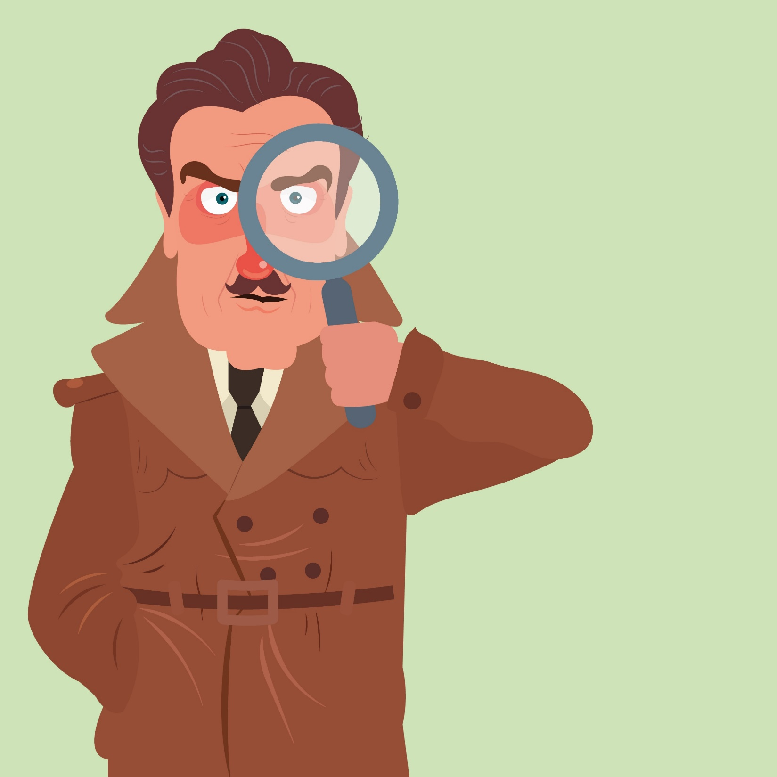

Fingering it Out!
Can we invent a new, better, or any way to classify fingerprints for the Effective Detective?
Students fingerprint themselves, compare and classify prints, create a database, and see how we might sort them into categories, just as fingerprint specialists do, in their training to become a more Effective Detective.

Slide 24
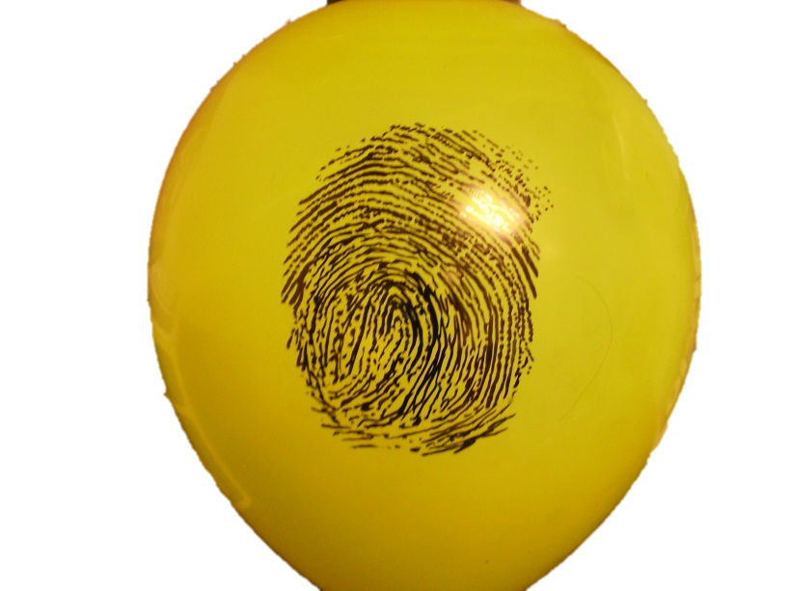
Ballooning Prints
Students get to study giant versions of their fingerprints with this fun activity!

Slide 25
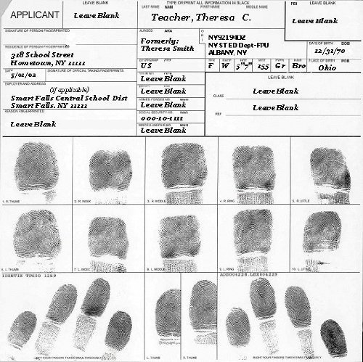
Printmaking
Students create a file of their fingerprints using graphite or ink on a chart or index card for your data base, labeling each print with the identifying finger information.

Slide 26
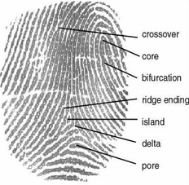
Compare and Contrast!
Then have them use magnifying glasses to compare their prints looking similarities and differences and find loops, whorls, and arches.

Slide 27
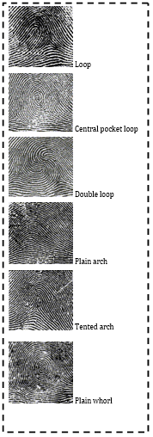
What do you have?

Slide 28

Weather Permitting?
Test fingerprints on a glass surface for their resistance to "sun" (heat), "snow" (cold) or "rain" (water). Using the classroom elements they have available, ex. conduct the heat test in an oven or microwave or with hot water. Use a freezer or ice cubes inside the glass for the element of cold, and imitate rainfall by spritzing or splashing the glass with water. Examine the fingerprints afterward with a magnifying glass and record the results. Which element and print combination has the best quality after exposure?

Slide 29
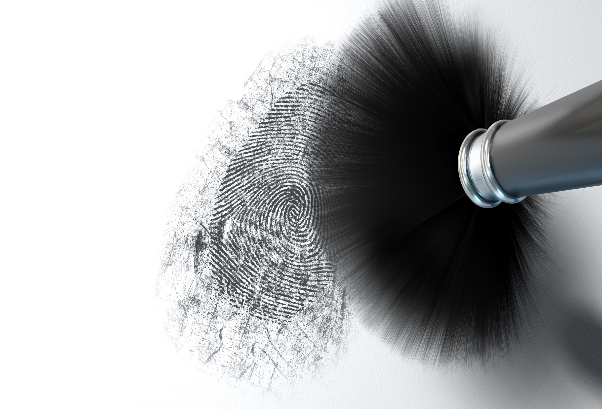
Dusting for Prints
Students dust for fingerprints from ‘evidence’ collected by the Effective Detective at the crime scene and use their recently created fingerprint classification system to match an unknown fingerprint from their known samples.
Note: Getting good results from dusting for fingerprints can be challenging, and may require plenty of practice.

Slide 30
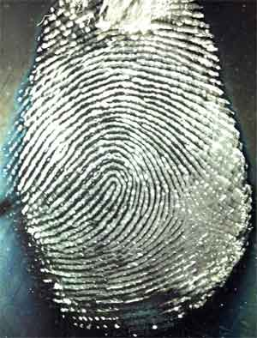
Super Discovery!
45780B
Explore the accidental discovery of the modern day use of superglue for developing or ‘fuming’ prints!

Slide 31
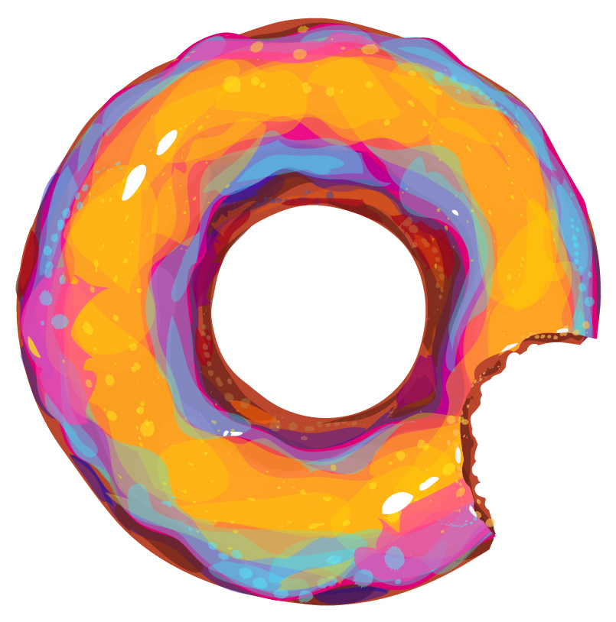
Leaving an Impression
45780B
Impression evidence is very important in the field of forensic science. Impressions that are left behind at a crime scene can provide clues as to the object or individual who may have left the mark.
We’ll explore two of the many types of impression evidence—footwear impressions and bite marks.

Slide 32
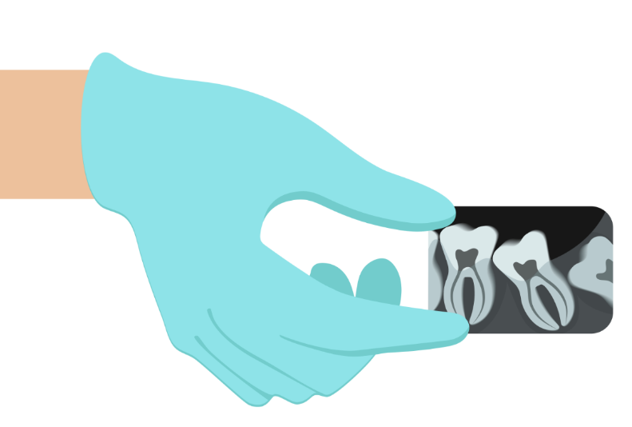
Bite Marks
45780B
Forensic Odontology (dentistry) has been used as far back as the Roman Empire to identify victims of crime and other mishaps.
Explore how forensic dentists use dental marks and analyze teeth to identify age and more! And learn how a few dishonest dentists caused a whole lot of heartache!

Slide 33
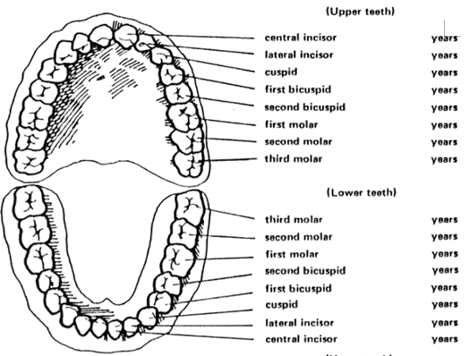
Do You Know When Your Teeth Come In?
45780B

Slide 34
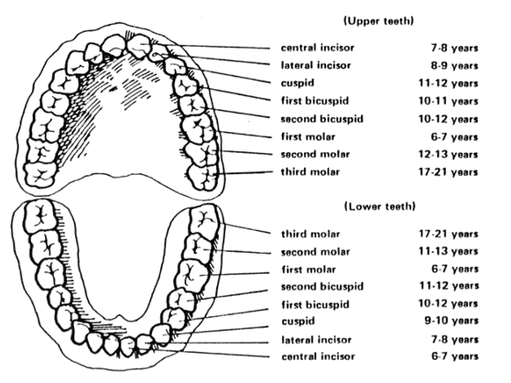
How could knowing this help investigators?
45780B

Slide 35

Taking a Bite Out of Crime
To have Probationary Gumshoes become handy at the science of forensic dentistry the Effective Detective wants them to get a bit of practice at making good impressions!

Slide 36

Dental Database
45780B
Using Styrofoam plates, markers, and transparencies students create a record of your unique bite pattern. Measure, note unique characteristics, and label teeth impressions (referencing the tooth chart for help with correct terminology, ex. missing lateral incisor.)
Then see if you can conquer the Effective Detective’s Case File Challenge and explore the Crime Scene Connection using Air Heads or Laffy Taffy!

Slide 37
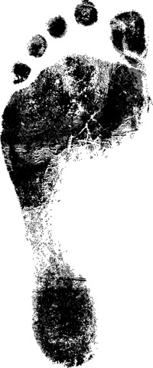
Leaving an Impression: Footprints
45780B
For years, criminal investigators and forensic scientists have used fingerprints to determine identity. More recently, footprints have been discovered to be an equally reliable identifier!

Slide 38
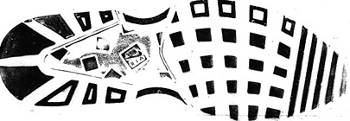
Don’t tread on me!
Most often, the prints at a crime scene do not come from a bare foot. To compensate, scientists have created methods of identifying shoe prints. The unique indentations on the ground made by any shoe can be studied, recorded, and matched to prints found at other locations. Therefore, if one set of shoeprints is found at the scene of a crime, it can be compared to another set of prints found at a separate crime scene.

Slide 39
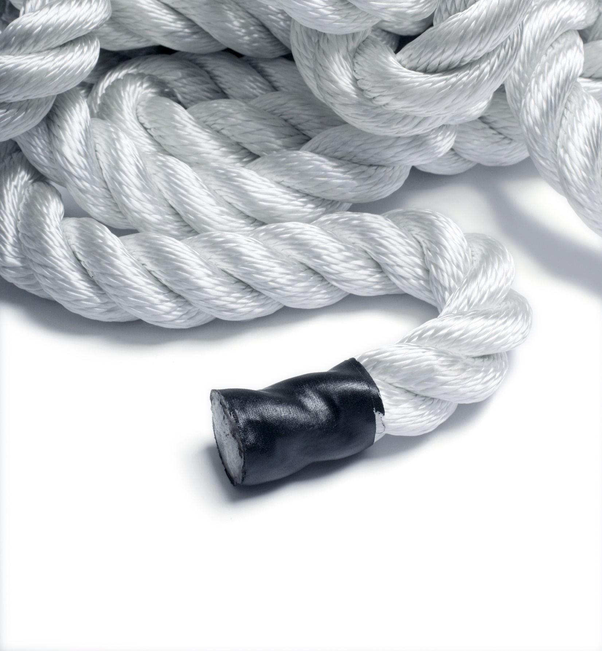
Your bones be tattlin’!

Slide 40
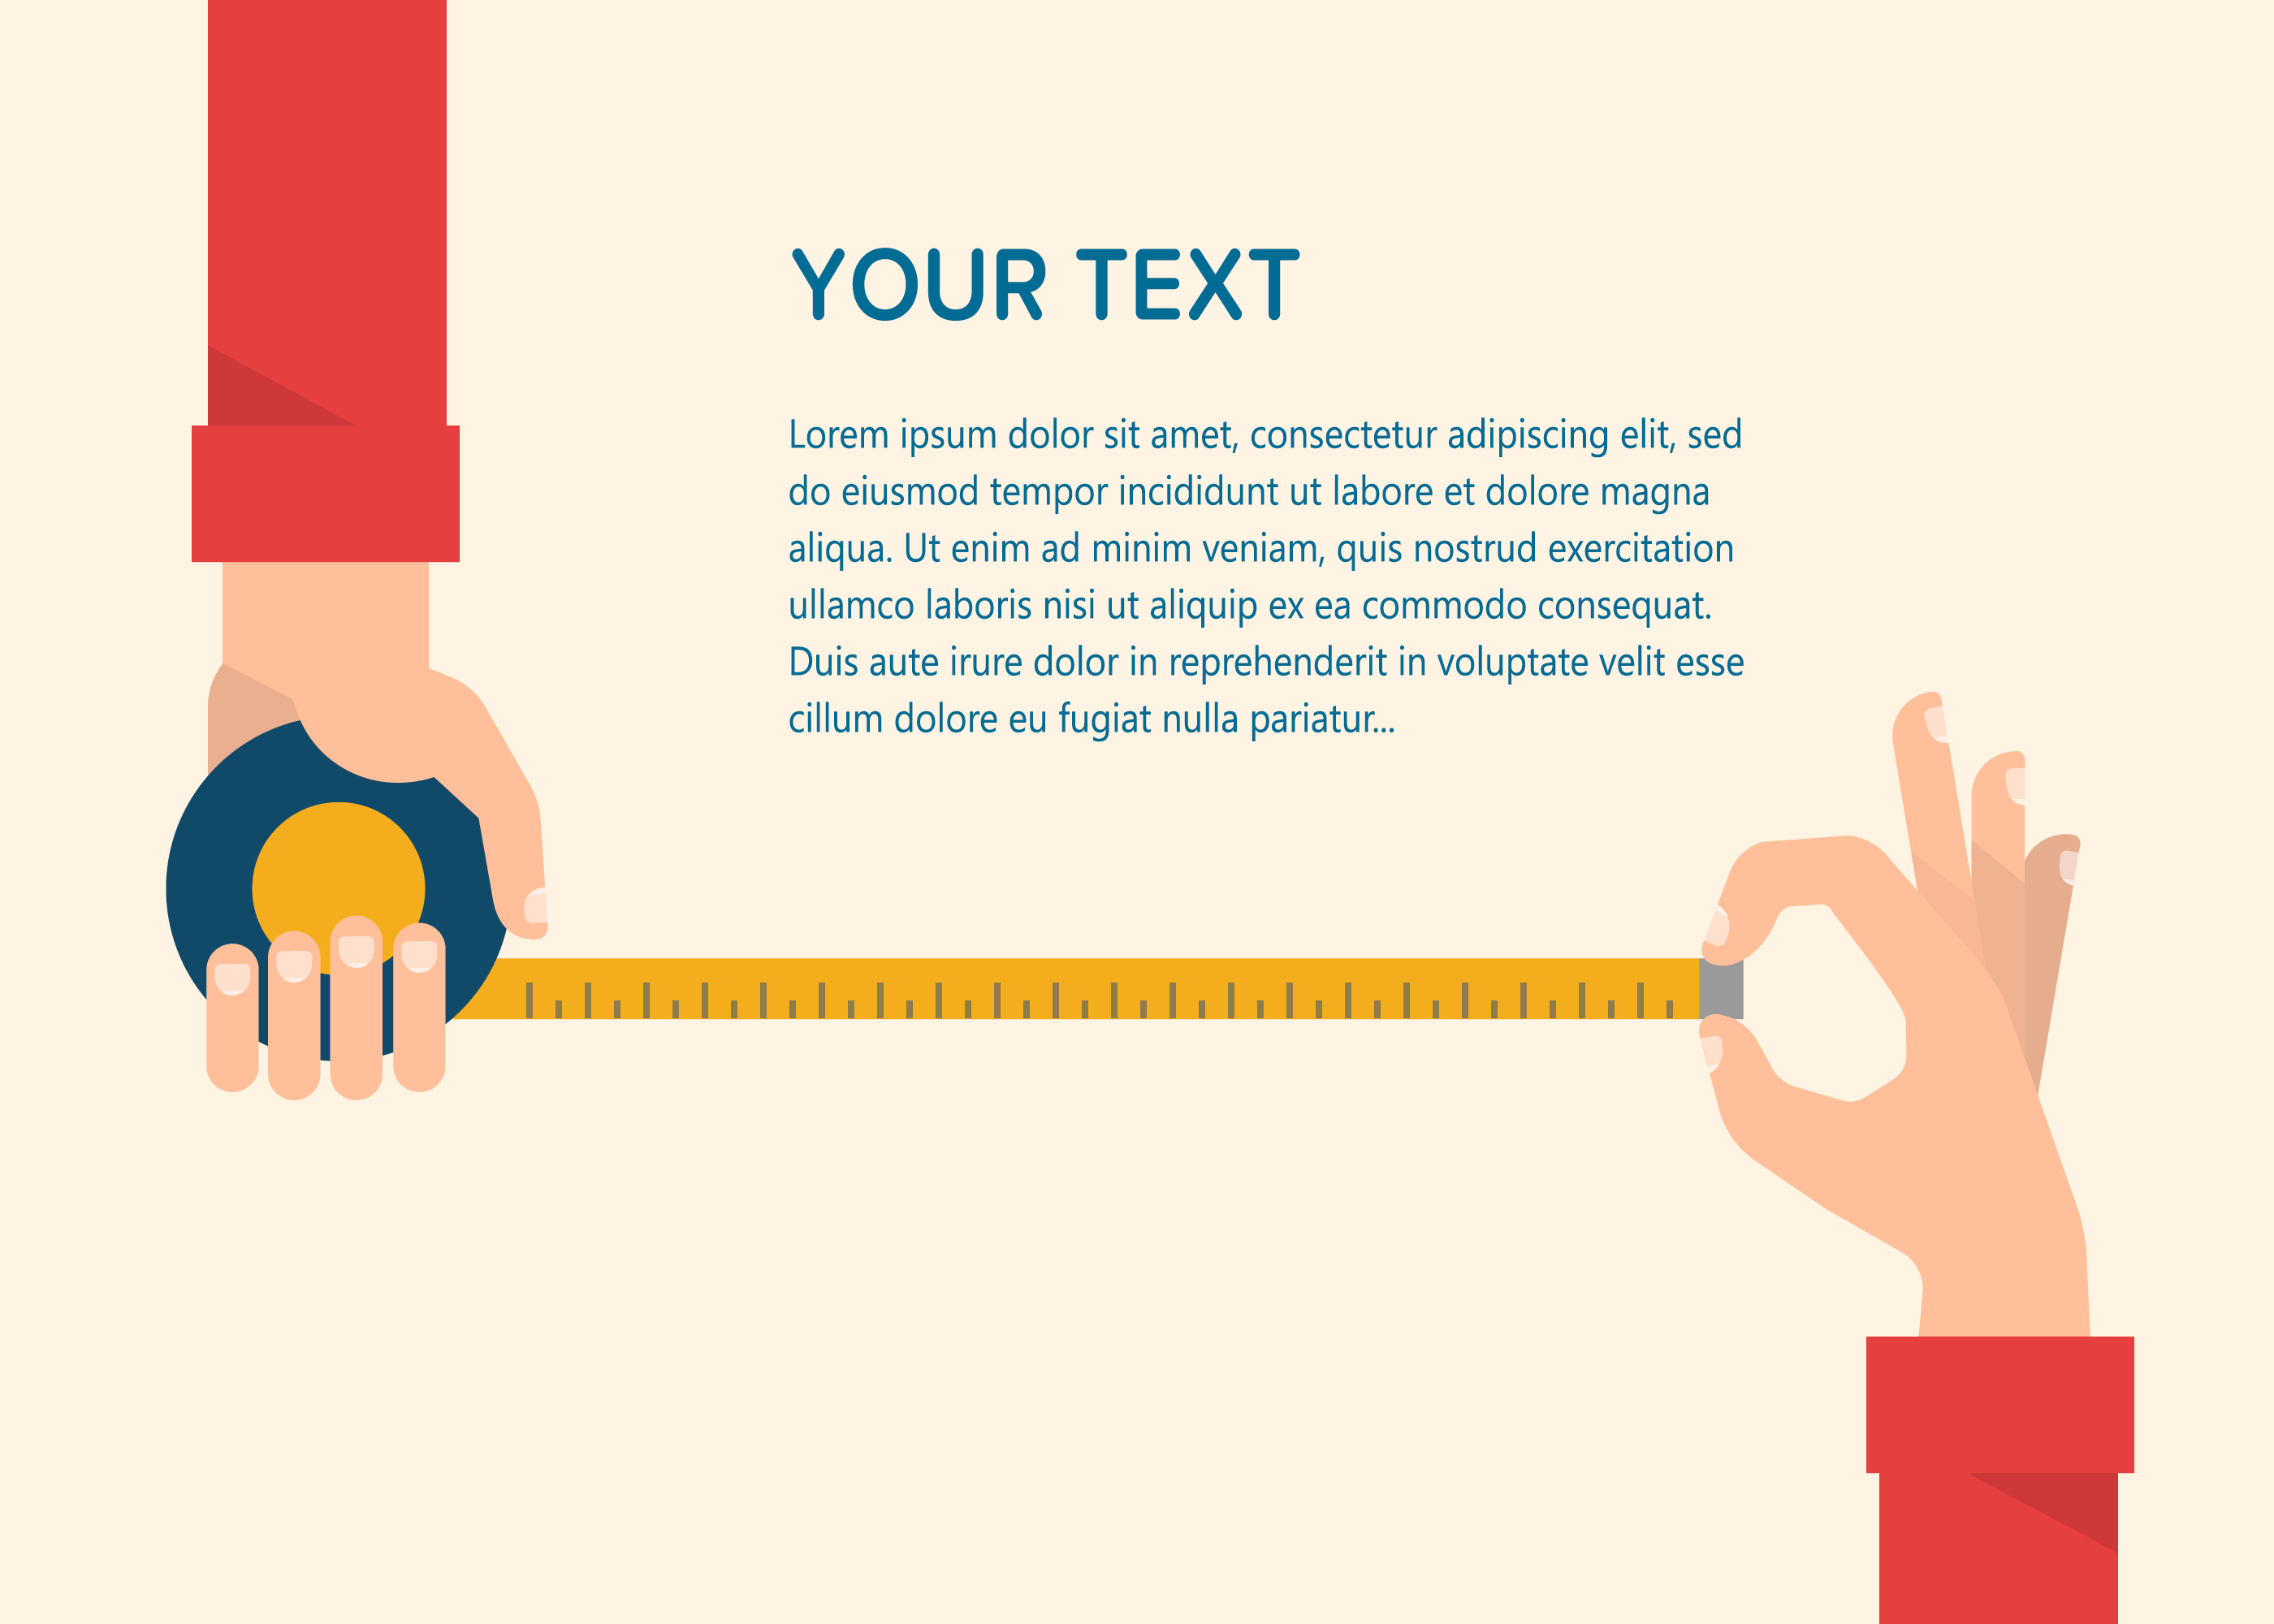

Your body is a remarkably coordinated system made up of many, many parts (206 bones, 589 muscles, and over one billion nerves), each with a unique relationship to every other part. This surprising and fun body proportions activity explores a unique connection between them.
All you need is a 7 foot piece of rope, a few binder clips, a small mirror, and a tape measure!

Slide 41
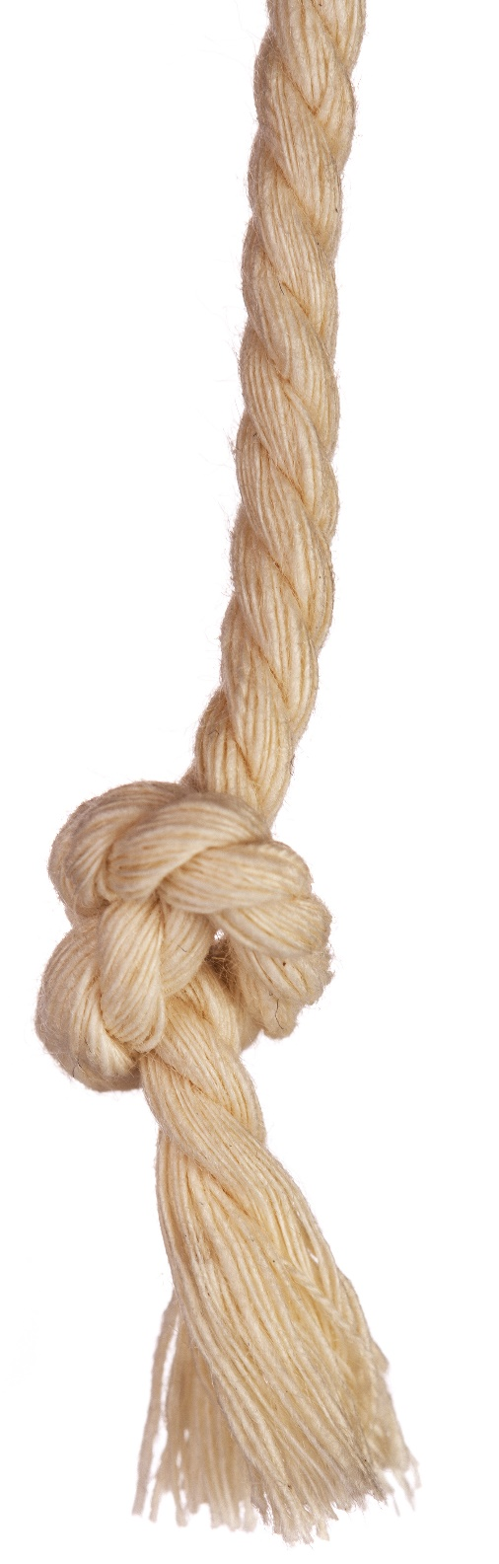

Let’s Begin: Measure Your Foot
Make sure there’s a knot at one end of the rope.
Remove your shoes.
Put the knotted end of the rope at the edge of your heel and measure the length of your foot from heel to toe—use a binder clip to mark this length on the rope. This is your own personal foot‖ measurement.
Leave the clip on the rope!

Slide 42

Now, Measure from Elbow to Wrist
With a group member or your partner’s help, use the same piece of rope and the foot length you just marked (don’t remove the clip!) to measure the distance from your elbow to your wrist (beginning again from the knotted end).
The length between your elbow and wrist should be the same as the length as your foot.

Slide 43

Then the distance around your clenched fist
With a group member or your partner’s help, again use the same piece of rope and the same length you already marked (don’t remove the clip!) to measure the distance around your clenched fist (beginning again from the knotted end).
The length of rope around your fist should be the same or nearly the same as the length as your foot and the length between your elbow and wrist.

Slide 44
And height of your head from your chin to the top of your skull
With a group member or your partner’s help, again use the same piece of rope and the same length you already marked (don’t remove the clip!) to measure the distance between your chin and the top of your skull (beginning again from the knotted end).
The length of rope from the top of your head to your chin should be the same or nearly the same as the length as your foot, the length between your elbow and wrist, and the distance around your clenched fist.

Slide 45
Your foot x 7
Now that you have a standard measurement, measure out a total of 7 of your foot’s lengths on the rope and mark that length with another clip.
Older students can do this by measuring their foot lengths on a yard stick and then multiply that length by 7, measuring out that length on the rope and marking it with a clip, while younger students can simply accordion fold the rope so they have a total of 7 of their foot’s lengths.

Slide 46
Note:
Multiplying the length of the foot times 7 is usually a close approximation for adults and kids that don‘t have a lot more growing to do.
For younger kids, multiplying by 6 works better. (For really young children, it doesn‘t work at all.)

Slide 47
Compare!
Working with your partner compare this new distance to:
Your total height, from the floor to the top of your skull.
The entire width of your out-stretched arm span.
You should find that they‘re all about the same length.
Do not remove the clip!

Slide 48
Tip o’ your nose to the tip o’ your finger!
This part is slightly less reliable, especially for children, but half of this larger measurement (halfway between the knot and your 2nd clip, or 3 ½ of your foot lengths) should be roughly equal to the distance from the tip of the nose to the tip of the middle finger (when arms are outstretched). On adults this measure should also be roughly equal to a yard.

Slide 49
Rope it in!
Using the rope again (we’re not worried about the clips anymore, simply using the rope itself) work with your partner to measure:
Twice around the base of your thumb, then compare that length to the circumference of your wrist.
Twice around the wrist, which should equal the circumference of your neck.
Twice around the neck will often equal the circumference of the waist on an average adult.
The distance from the outside corner of your eye to the corner of your nose on the same side will equal both the height of your ear, and the width of your mouth.

Slide 50

What can we conclude?
When a forensic scientist has the length of a foot, the forensic scientist will be able to approximate the height of the individual and more!

Slide 51
What’s going on? How do they do it?
Forensic Osteology is the study of bones. It is through the use of Osteology (how bones are formed, interact, age, and change over time) that investigators are able to analyze human remains.
A person‘s individual proportions are so unique that this style of relating is the basis for forensic reconstruction, such as seen on television where they take bones and figure out what someone may have looked like.
Using a person‘s foot, the total height of the person in question can be estimated, and if the skull is present, the measurements you just took can be used to reconstruct the shape of all the cartilage and soft tissue which is likely to have decayed.

Slide 52
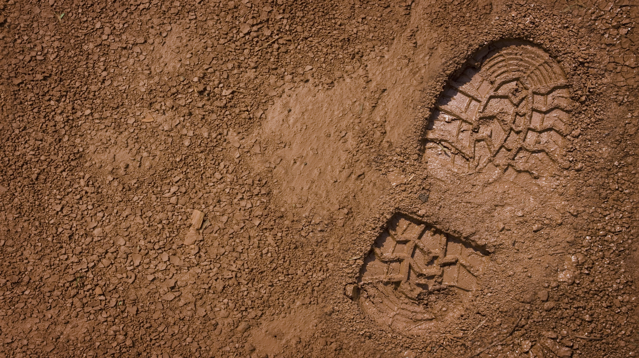
Making Tracks!
Using their observation skills, Probationary Gumshoes identify and compare footprints and shoe tracks placed at various stations around your classroom Crime Investigation Lab.

Slide 53
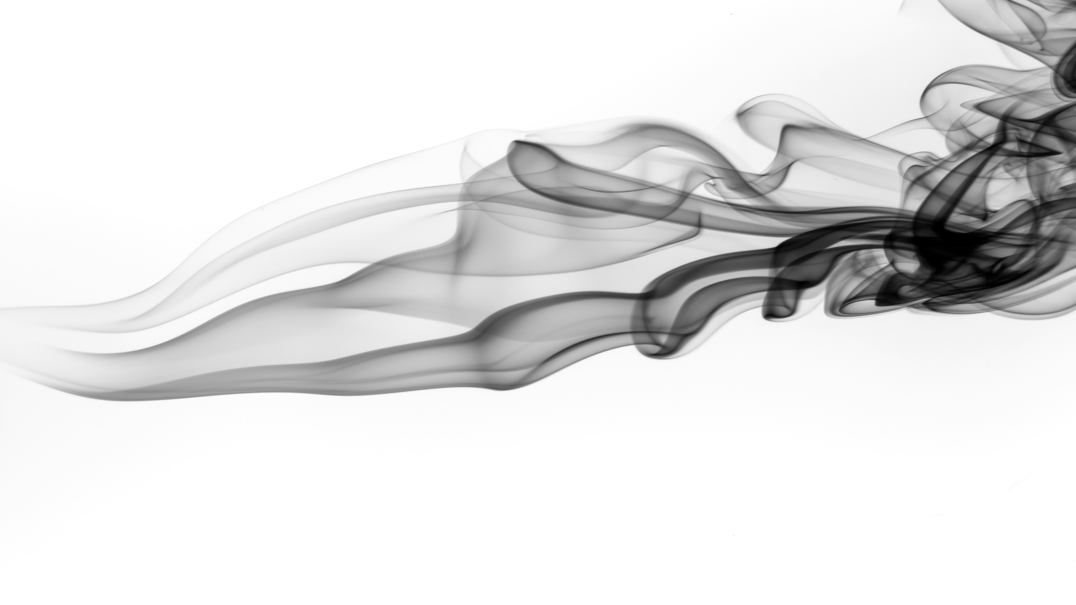
Chromatography
Black ink is black ink, right? Maybe not! Even though the ink from different pens looks the same, it might actually be made of many different dyes.

Slide 54

Inking the Evidence with the Crime
The Detective has a note in from her evidence files written on absorbent paper by someone using a felt-tip pen.
Gumshoes, she needs you to separate the dyes in the ink from different pens to make different patterns and figure out which of the pens she collected from the suspects is the right one, while she works on another case!

Slide 55
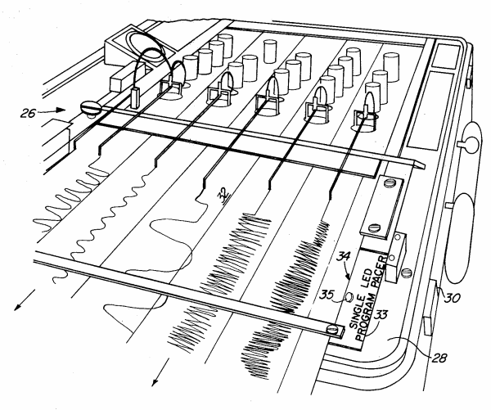
Liar Liar, Glands on Fire
The concept of a lie detector is centuries old! Explore ancient techniques (chewing dry rice sound nice?) and more modern methods before trying a fun challenge from the Detective where Gumshoes make their own lie detector and create their own polygraph process.
Can you pass the test?

Slide 56
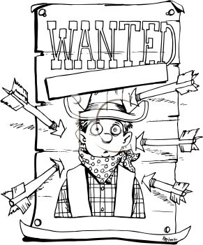
Wanted! Keeping an Eye on Crime
Being an effective detective is all about simplicity . . . making the most out of what you have. Your Probationary Gumshoes will get a kick out of creating their own Outlaw’s personality while learning about facial proportions!

Slide 57
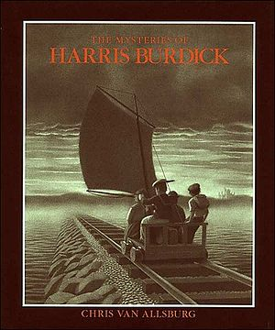
It Was a Dark and Stormy Write…
Mysteries are a great way to hook students into writing about fictional happenings and an Effective Detective sees enough weird and wacky happenings to populate an entire library of characters!
Probationary Gumshoes learn about The Mysteries of Harris Burdick and trying to solve the mysteries within the book. But the puzzles, the mysteries, presented by these drawings, are not what we are used to. They are not solved for us, as in the final pages of a book or a film’s last reel…

Slide 58
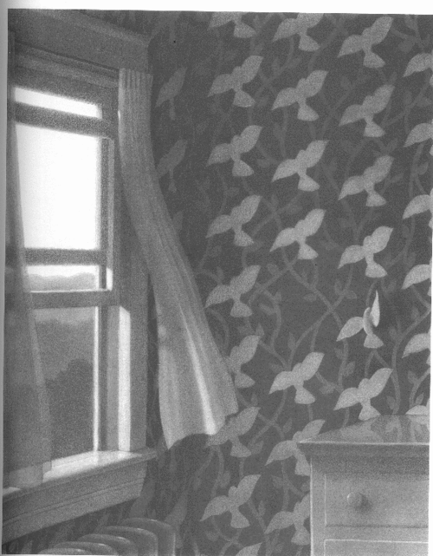
A Mysterious Beginning
Probationary Gumshoes’ final assignment before graduation is to unravel the mystery from one of Burdick’s pictures in the story by writing a creative mystery that goes with the image of their choosing from the book.
Once their stories are written, they will be read aloud and the other Gumshoes will be responsible for figuring out which image from the book their story represents.
Note: Gumshoes may want to use the captions from the book as the first line of their stories.

